Slide 1
Project Presentation on Color Sorter Machine Course Code: 400(B)
Presented By:
Mostafa Ahmed An-nur Polash Mahmud
Roll:17102024 Roll:17102017

Slide 2
CONTENTS
Introduction
Project Scope and Goal
Software Technologies & Hardware Tools
Hardware Features
Pictorial Diagram
Flowchart
Limitations
Conclusion

Slide 3
Introduction
Color sorting is sorting things according to their color.
Sorter first recognize the color of an object with color sensor.
Different carriers are labeled for deferent colors.
Servo motor rotates and puts object in a carrier labeled by that color.
This process keeps going on and on until all the objects sorted.
3

Slide 4
Project Scope and Goal
Scopes:
This device may be used as color sorter.
This device can be used as an object sorter.
Children can use it as toy.
This device may be used for mentally disordered patient.
NGO can use this device.
Small Industry can use this device.
Goals:
1. To design a Color detecting machine
2. To design a Low cost machine
3. To design a Easy to use machine.
4

Slide 5

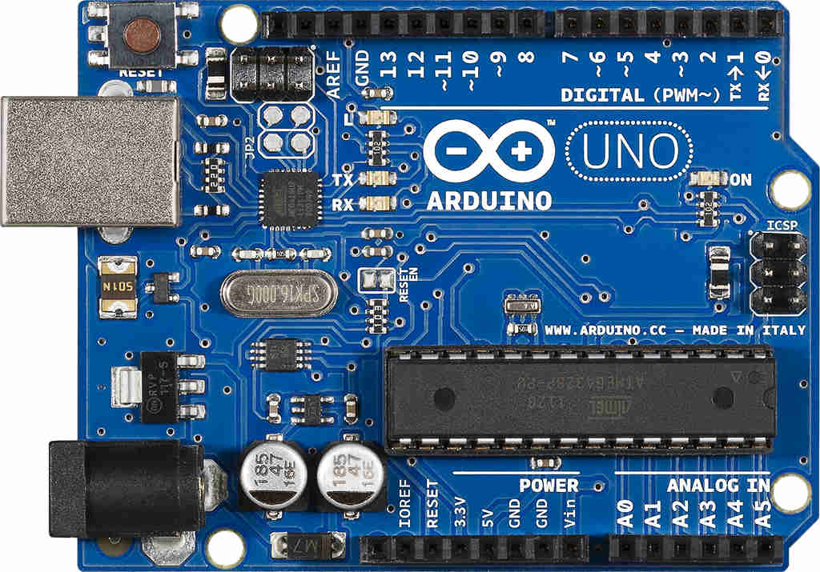
Software Technologies & Hardware Tools
Fig: Arduino IDE Fig: Arduino UNO R3
5

Slide 6
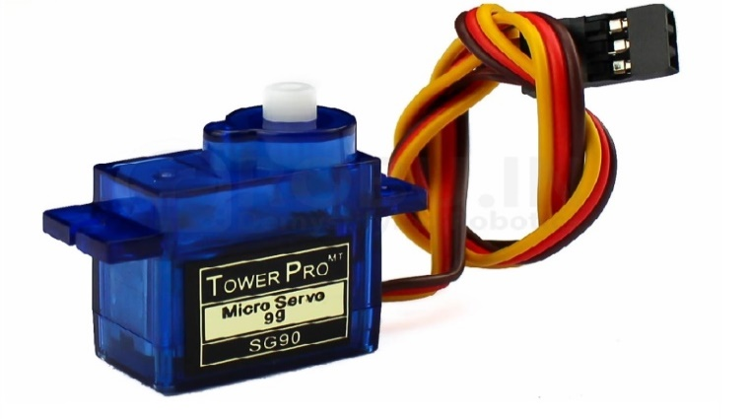
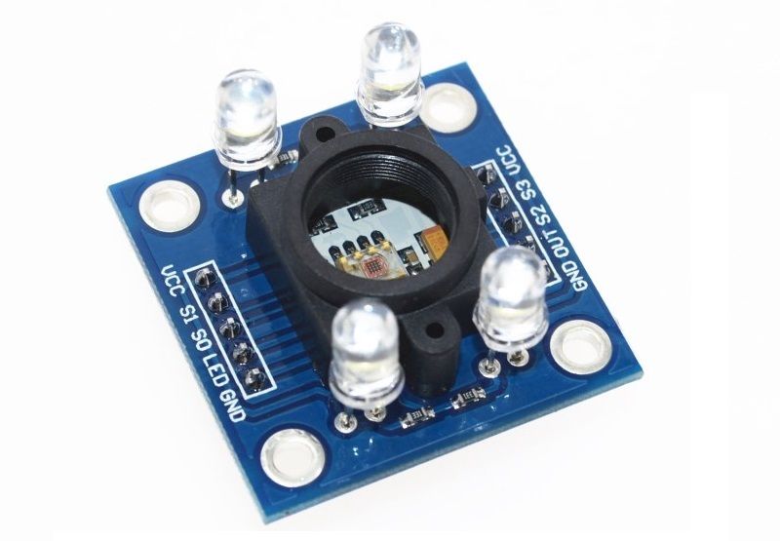
Software Technologies & Hardware Tools(Cont.)
Fig: Servo Motor Fig: TCS3200 Color Sensor
6

Slide 7
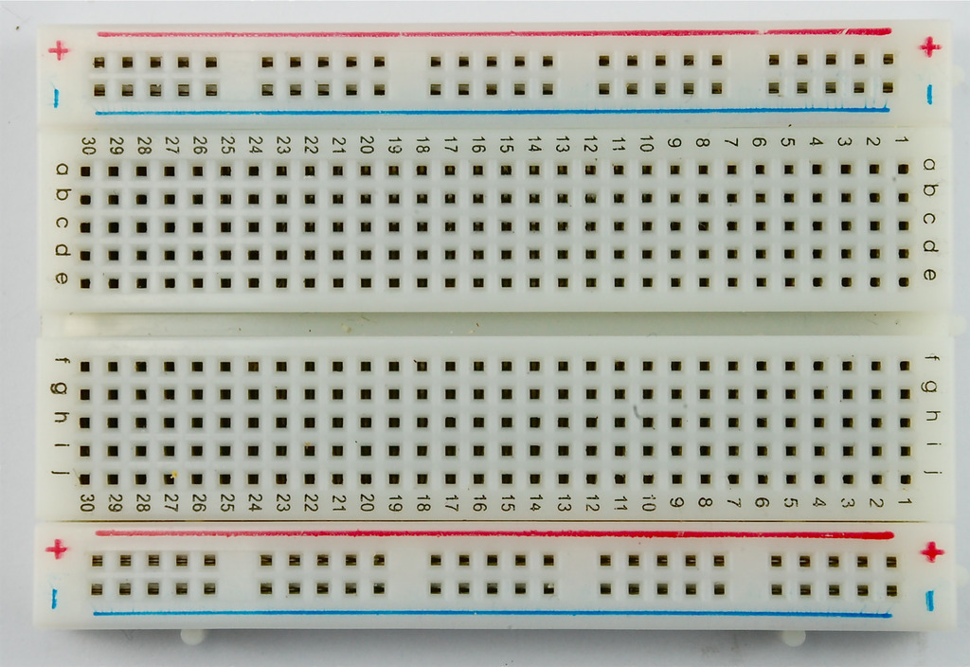
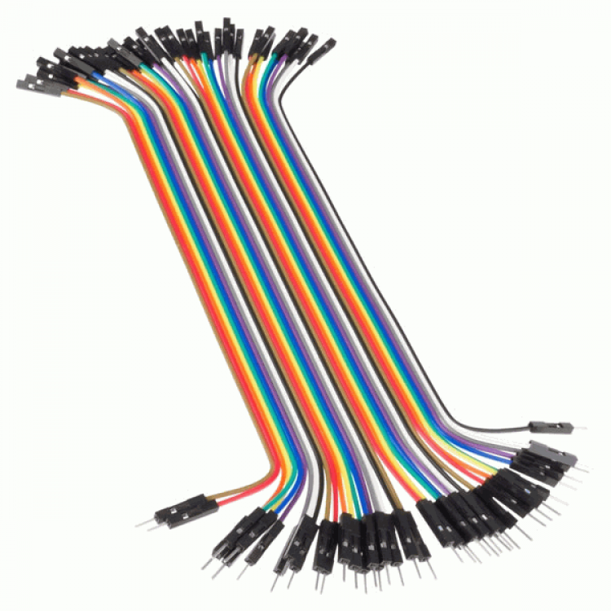
Software Technologies & Hardware Tools(Cont.)
Fig: Breadboard Fig: Jumper wires
7

Slide 8
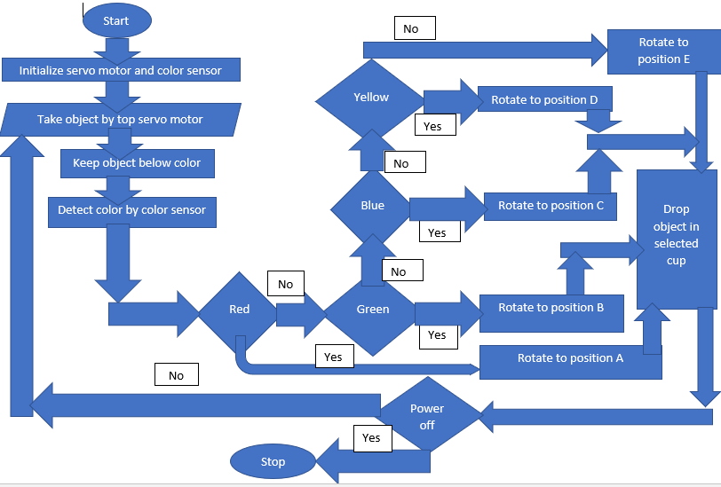
Flowchart
8

Slide 9
Hardware Features
The device can detect colors.
It can sort different colors by color sensor putting them in different compartment.
As the Arduino is programmable , so developers can program the device as required.
By changing colors in program , people can use the device for various colorful object sorting.
9

Slide 10
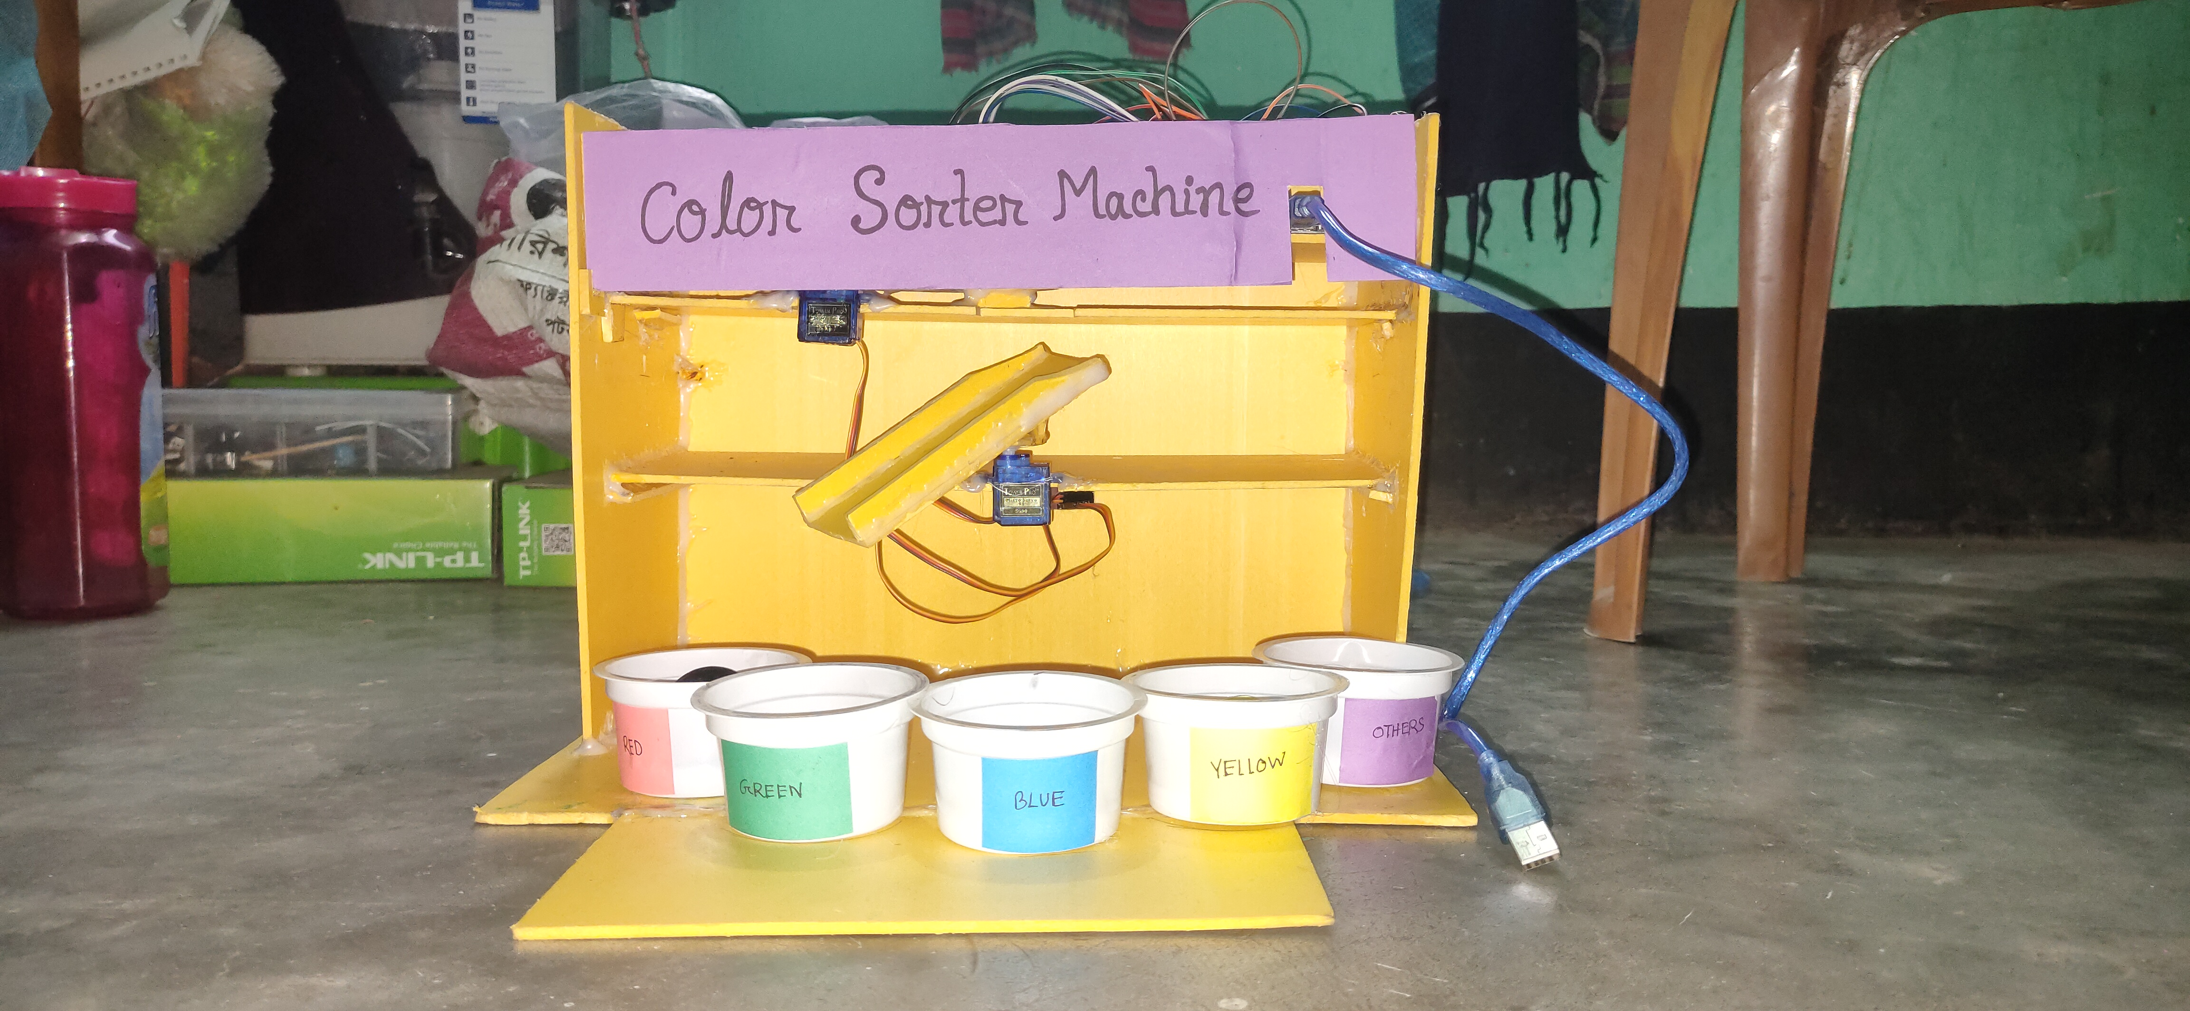
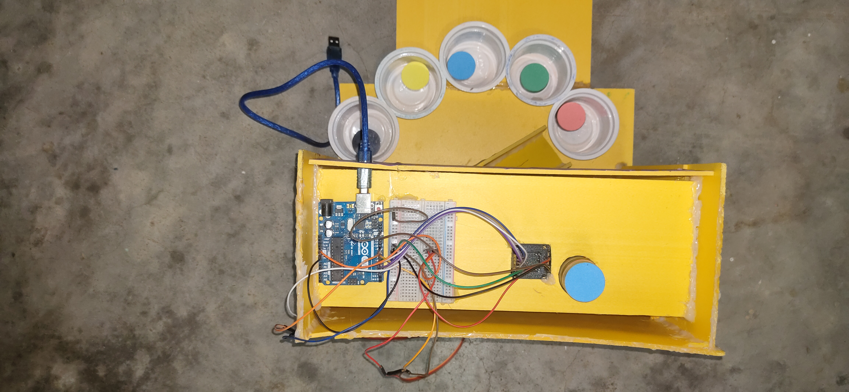
Pictorial Diagram
10

Slide 11
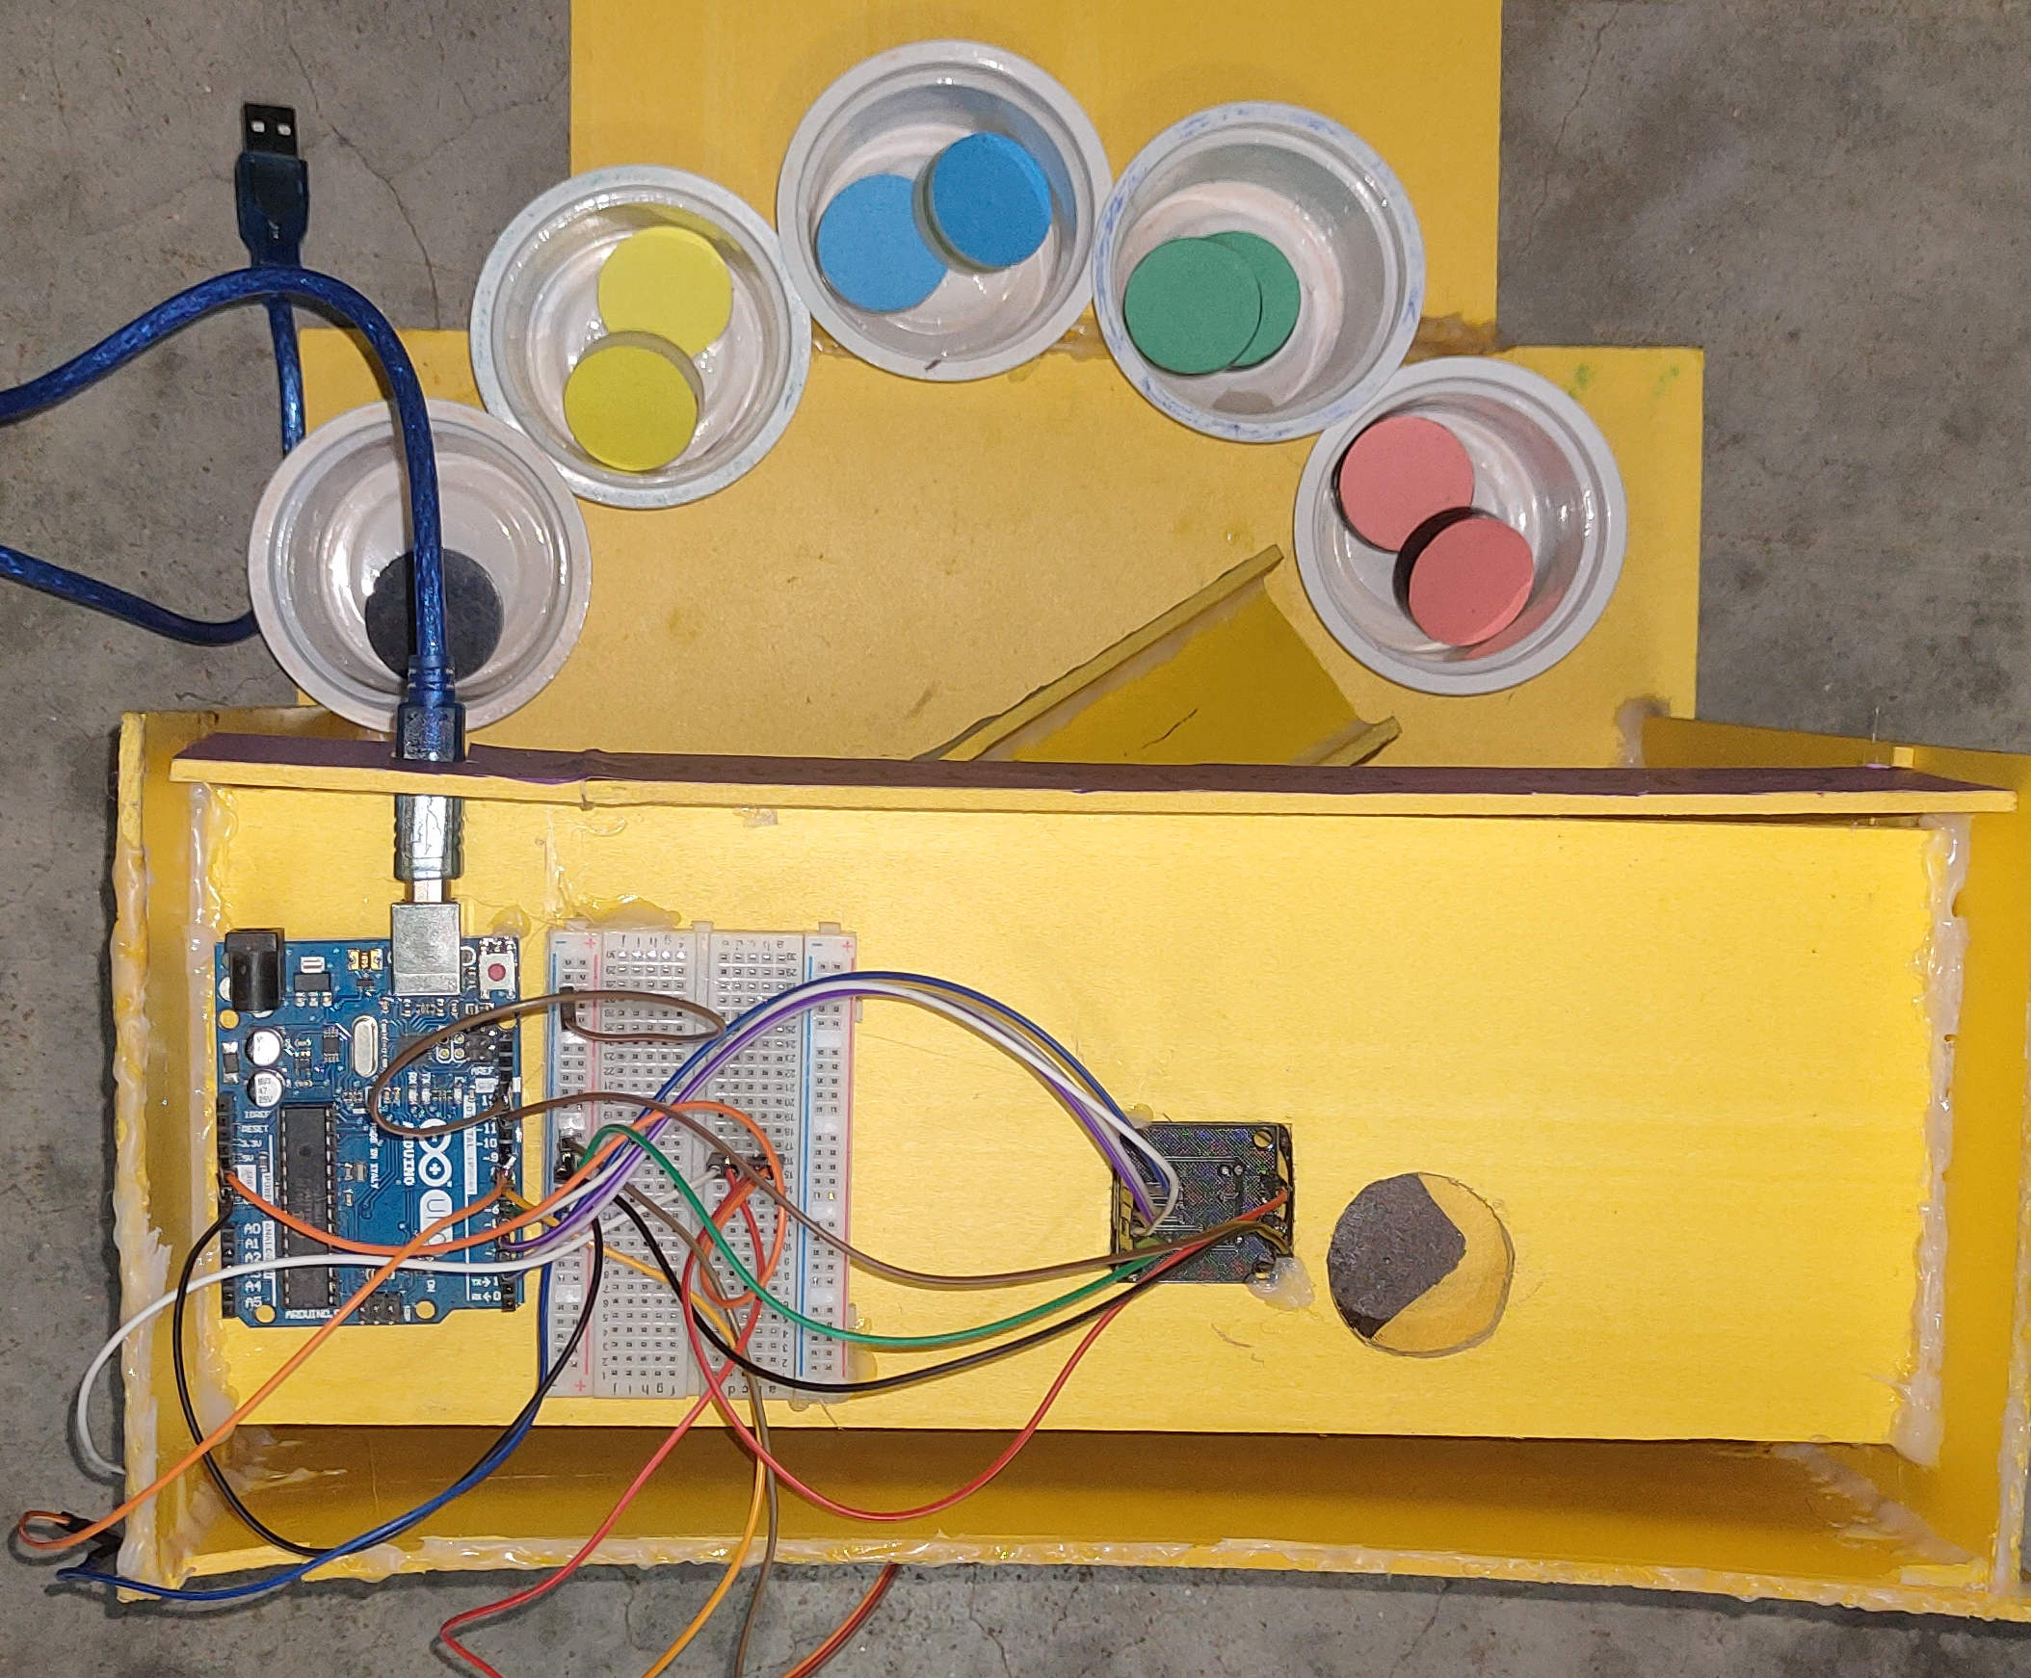
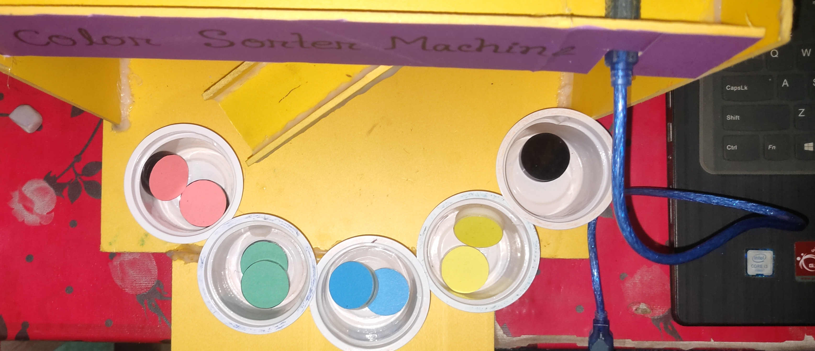
Pictorial Diagram
11

Slide 12
Limitations
The objects used in project are not real life objects.
More than 4 colors can’t be sorted for the project being small.
There is no built-in server to automatically change colors for sorting.
12

Slide 13
Conclusion
Nowadays, instruments for different use are advancing as well as people’s need for ease in work increases.
Industrial technology is getting more digital and automated.
For more purposes, this initial design of project can be developed further more to add many other features which will digitalize the industrial system in different fields of daily life.
13

Slide 14
THANKS!
Do you have any questions?

